Slide 1



WELCOME TO
Digital Logbook Maintenance System
Presented By

Slide 2
Group Members
Charlie B
Capt Ishrak Jahan Ema
Lt Labiba Islam
Lt Lopa Ahmed
Lt Tanvir Nahian Swapnil
Lt Safkat Rahman

Slide 3
AIM
The Aim of the Presentation is to Give the Overview of Our Project

Slide 4
Scopes
Project Features
Summary of 2020
Planning Of 2021
Work Distribution
User Interface Design

Slide 5
Project Features
Easy excess for the Quarter Master of Logbook
Add reminders
Contact with the maintenance authority with just one click
Easily handle and update the logbook
See reports in an instant.
Easily access any information
Web based application features

Slide 6
SUMMARY
Lets dive in the year 2020 to see what we did to come up to this day !
2020

Slide 7
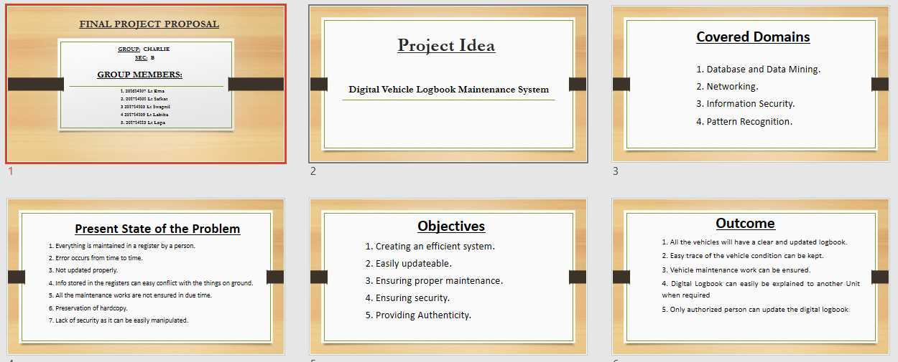
Project Proposal

Slide 8
Project Scheduling
We have tried to maintain the Project Timings Using the Microsoft Projects
The Start time of the project was 13th August 2020 And we have planned to end the project by 30th May 2021.
The overall project is going to be completed by The group members of Charlie B .

Slide 9
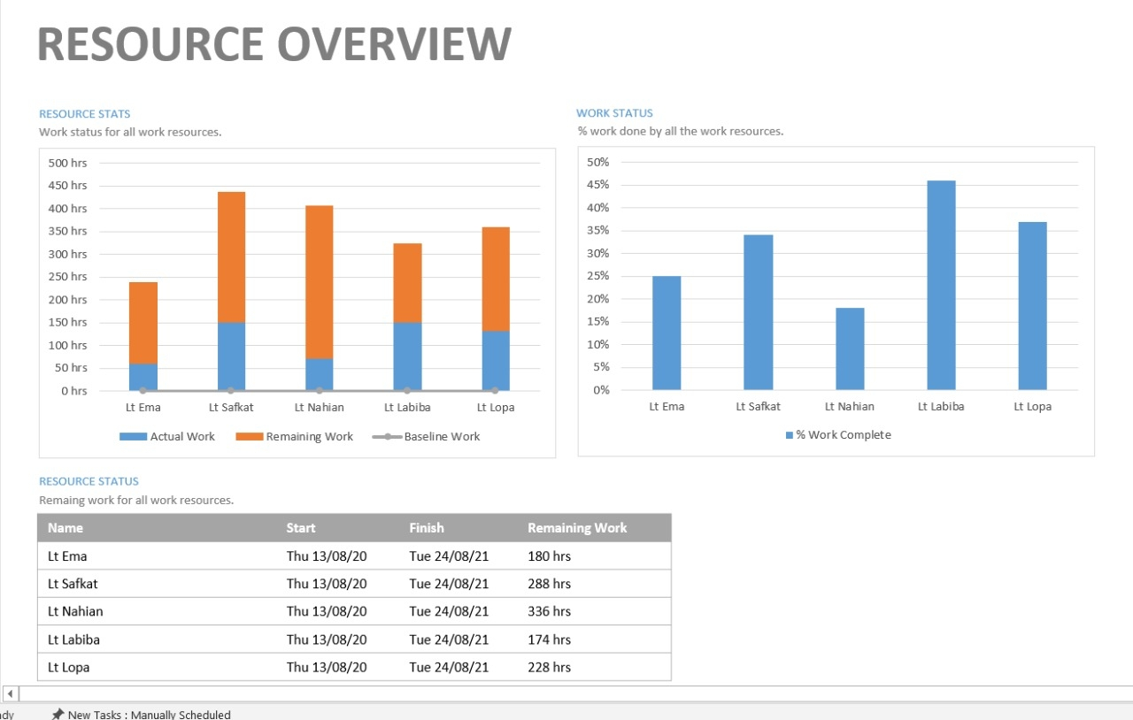
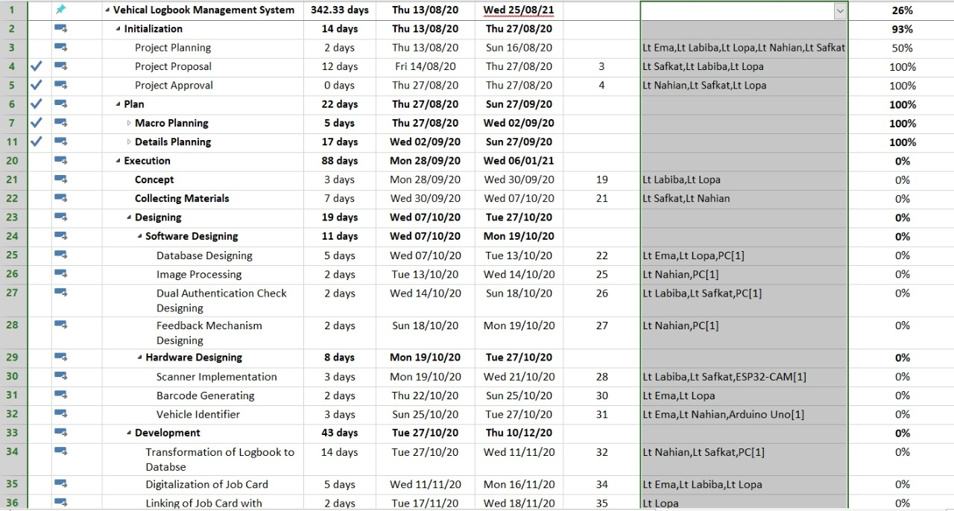
Project Scheduling

Slide 10
User Requirements
Security has to be ensured and given with highest priority.
The product should have App version usable on mobile mainly for android.
The App should have access for Read-only purpose.
Digitalized version of logbook updating and maintenance should be provided.
Digitalized version for work order and job card to be provided.
Authentication system must be provided from both user unit and workshop.
Repair process mainly spare parts supply should be digitalized.

Slide 11
System Requirements Specifications
System Requirements
Image Processing App version
Desktop version
Authentication approval
Overall supervision
System Requirements
Authentication checking
Updating database from Job Card
Digitalization of repair process
Job card updating

Slide 12
System Requirements Specifications
Requirement Classification
Serial | User Requirements | Types Of Requirement
 |  | Functional | Non-Functional
1 | The App should be highly secured | X | √
2 | The App should be portable in mobile devices | √ | √
3 | The App should be able to be read-only purposes | √ | X
4 | Digitalization of logbook updating and maintenance | √ | X
5 | Authentication system | √ | X
6 | Digitalization of spare parts supply process | √ | X
7 | Digitalization of work orders and job card | √ | X
8 | Overall monitoring system | √ | X

Slide 13
System Architecture
User Interface
Work Order Management
View Logbook
Scan
Vehicle
User Interface Management Authentication
Identification Of Vehicle
Job Card Management
Authorization
App Service /
Business Logic
Scan Parts
Info Update
Feedback
Verification
System Support
Search
Logbook Storage
Login and Monitoring

Slide 14
System Model
Context Diagram
R I & I
View Logbook
Job Card Data
Workshop Officer
View Logbook
Authentication Request
Update Logbook
Permission
Authentication Confirmation
Vehicle
DLMS
BA Number
Workshop NCO
Quarter Master
Work Order
Authority
Servicing Report
Maintenance Report
View Logbook
Ok Report

Slide 15
System Model
Use Case Diagram
User
System
Admin
Authentication
View Logbook
Workshop Officer
Generate WO
Close Logbook
Quarter Master
Update Logbook
R I & I
Scenario From Unit end

Slide 16
System Model
Use Case Diagram
Admin
System
Admin
Job Card Open
Scanning of vehicles and parts
Issue of parts
Workshop NCO
Date of repairing
Update logbook
R I & I
Verification
Workshop Officer
Closing Report
Scenario From Workshop End

Slide 17
System Model
Log in
Activity Diagram
No
Authentication
check
Yes
View Logbook
Homepage
Vehicle require maintenance
Yes
Generate WO
Insert Info
Scenario From Unit End
No
Authorization
Send
Log Out

Slide 18
System Model
Login
No
Authentication Check
Activity Diagram
Yes
Home
View Logbook
Generate Job Card
Authorization Notification
Entries
Next Maintenance Date
Scan vehicle
Verification
Scan parts
Closing
Scenario From Workshop End
Repair Input
Update
Log Out

Slide 19
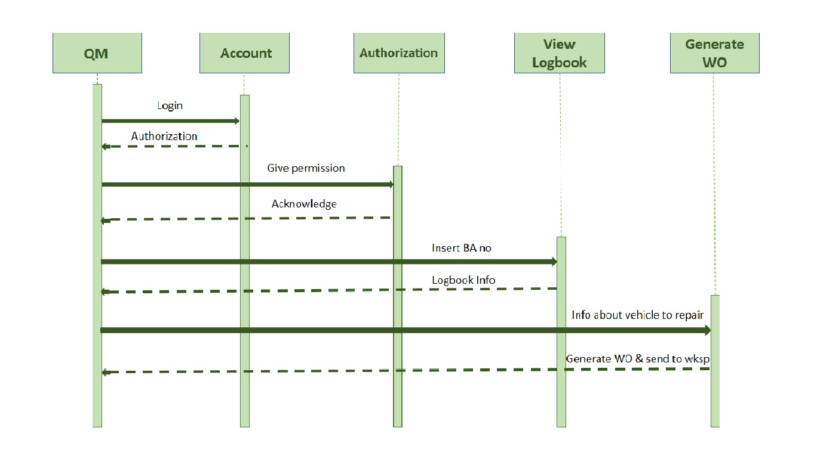
System Model
Sequence Diagram
Scenario From Unit End

Slide 20
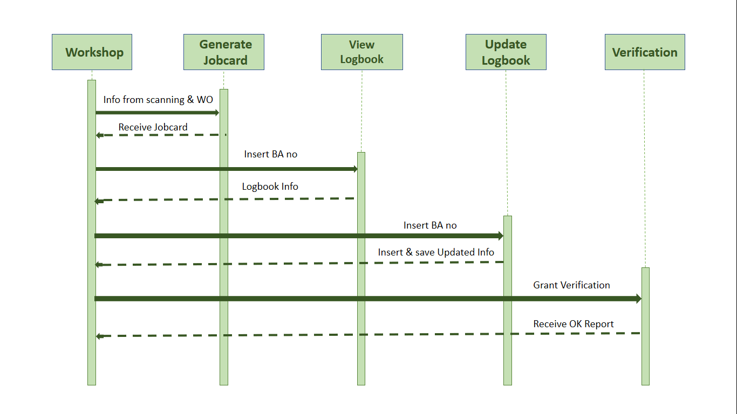
System Model
Sequence Diagram
Scenario From Workshop End

Slide 21
Lets Travel Back to today
2021

Slide 22
Planning
O We are planning to develop the web based browser app (UI) by week-4
O Design and implement Database by week-6
O Buy products and assemble hardware by week-5
O Implement Hardware and software inter connections by week-8
O Develop the responsive version by week-9
O Check for further improvements and complete the project by week-10 on 30th May.

Slide 23
Work Distribution
Charlie B
Capt Ishrak Jahan Ema
Documentation &
UI Design
Lt Labiba Islam
Hardware
Design
Implementation
Lt Safkat Rahman
Lt Tanvir Nahian Swapnil
Software
Database
Hardware-software connection
Lt Lopa Ahmed

Slide 24
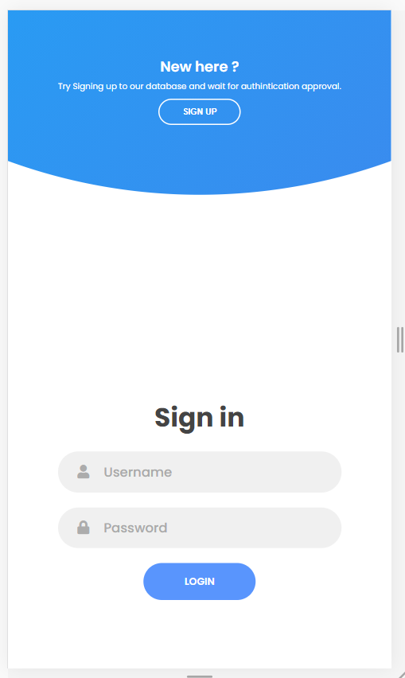
User Interface Design

Slide 25
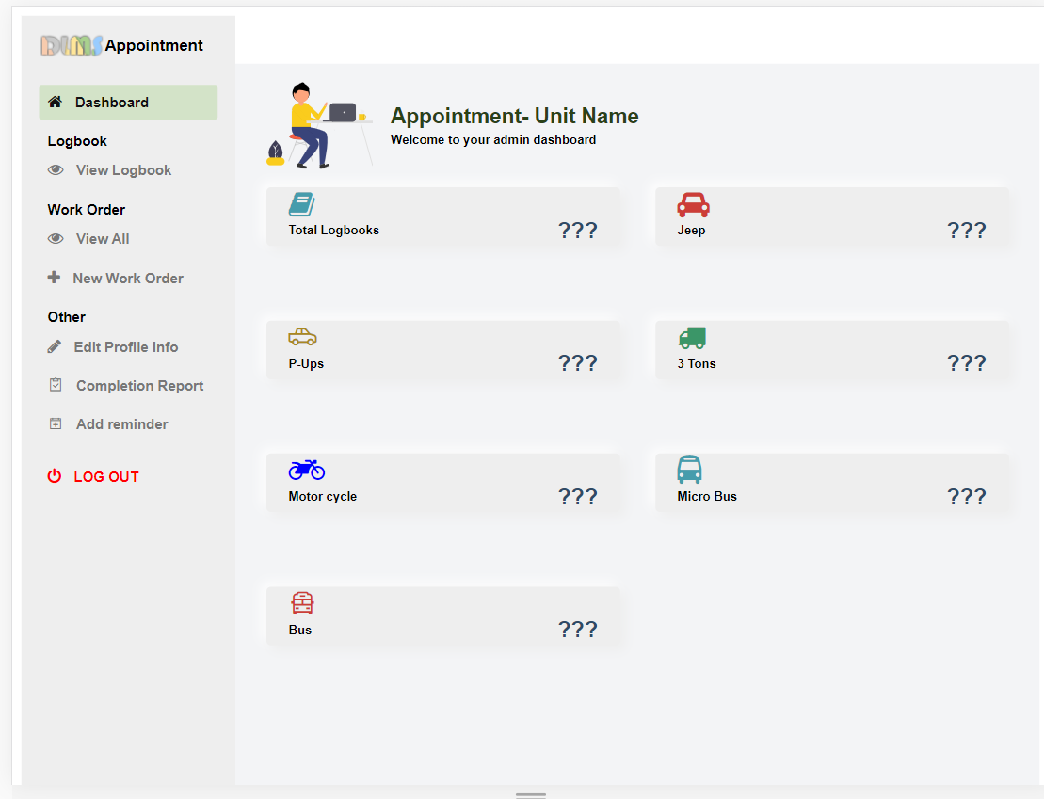
User Interface Design

Slide 26
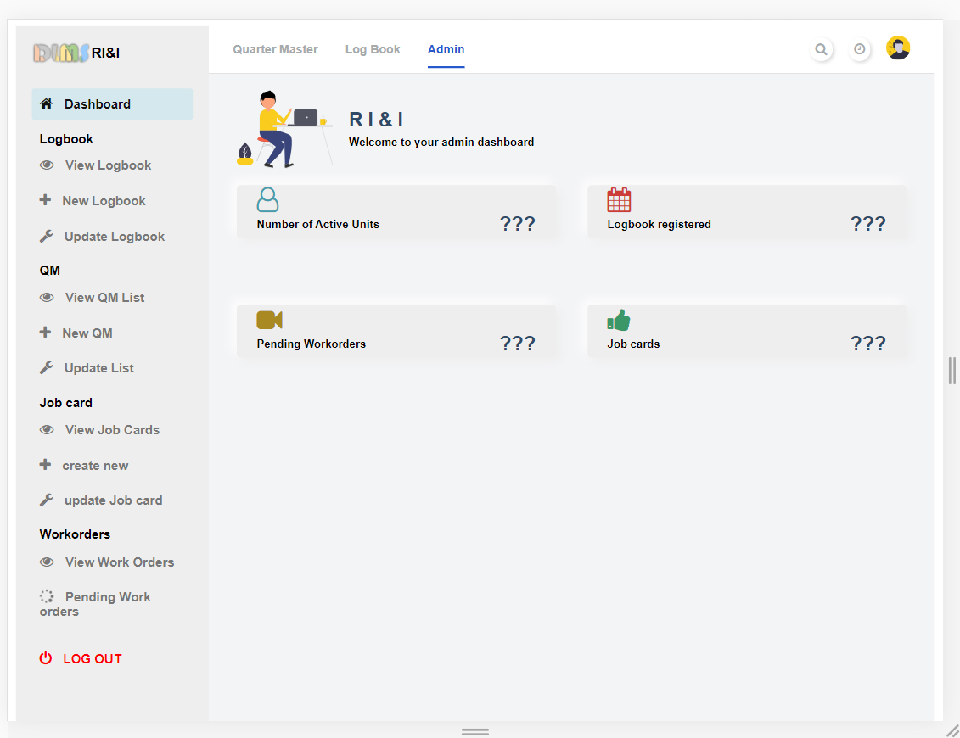
User Interface Design

Slide 27
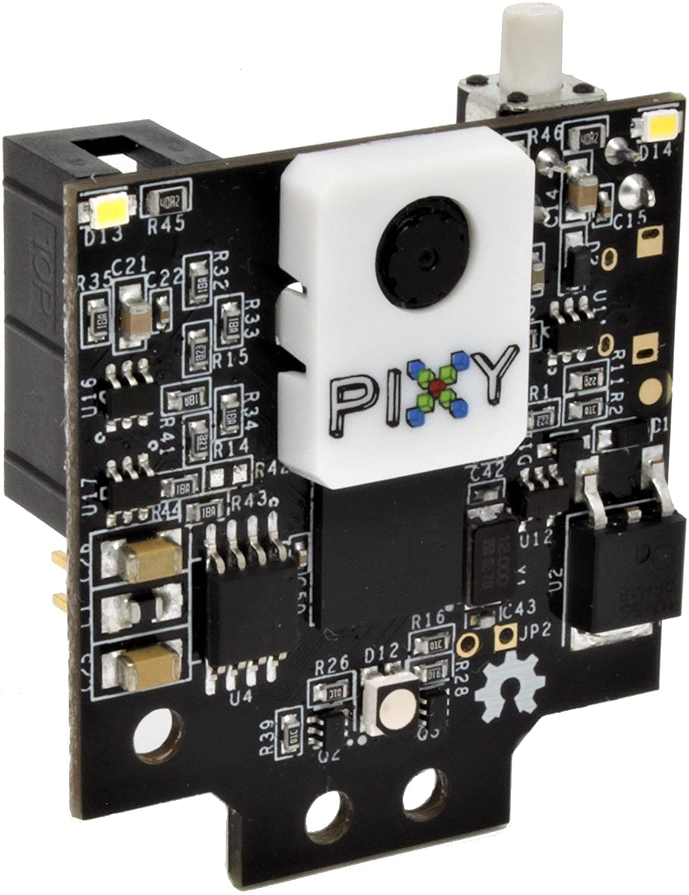
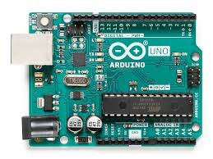
HARDWARE PLANNING
Taking picture through PIXY camera.
Connect it to a microcontroller and get the pattern.
Match with BA no and access database.

Slide 28
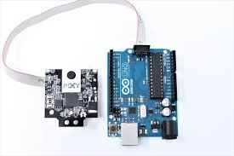
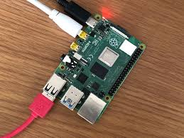
Fig-2: Connection with raspberry pi
Fig-1: Connection of Arduino with PIXY
Camera

Slide 29
Hardware implementation
Generating barcode for spare parts and get the part number.
Barcode scanner from the spare parts.

Slide 30
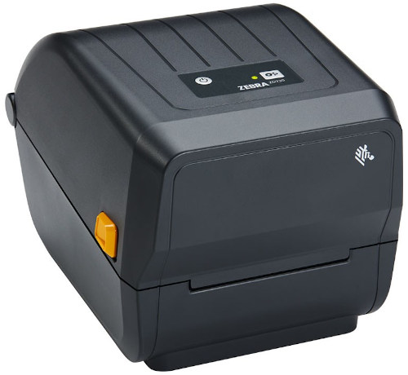
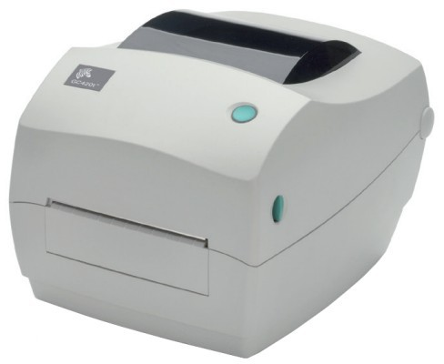
Barcode generator
Zebra ZD230
Zebra GC420t

Slide 31
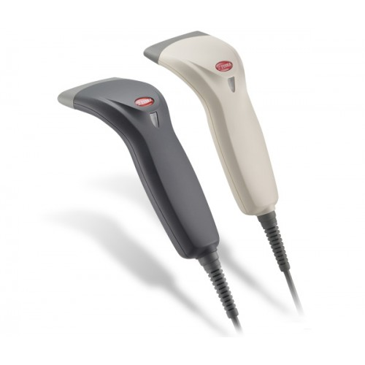
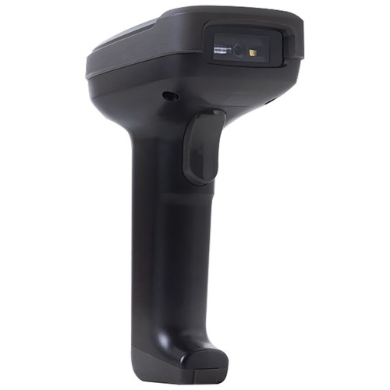
Barcode scanner
Zebex Z-3220
Deli E-14952

